Slide 1
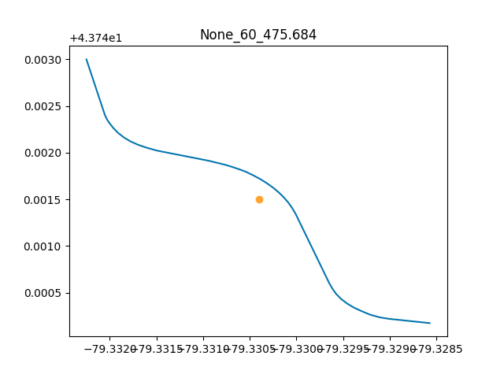
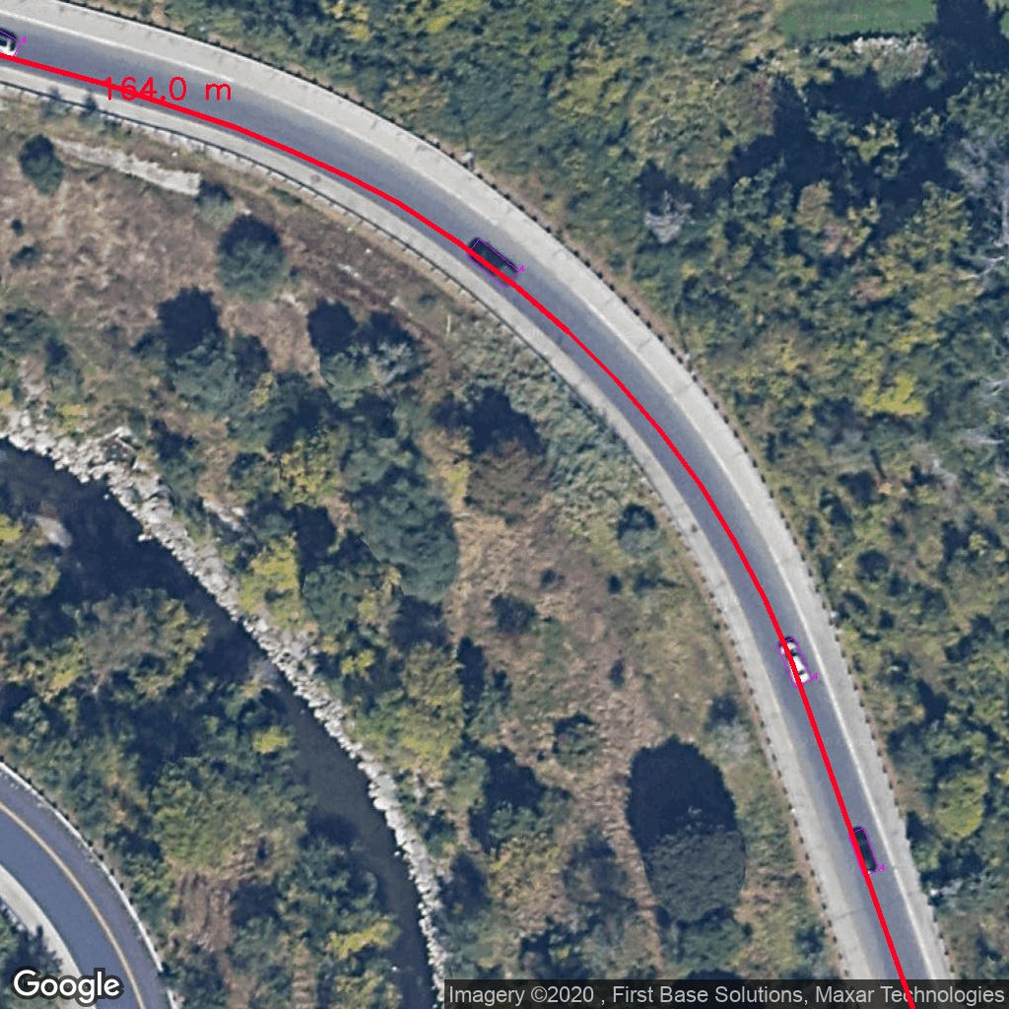
Add shapefile to image
Road length in the image
Road name
SPD limit
Road length
Latitude
Longitude

Slide 2
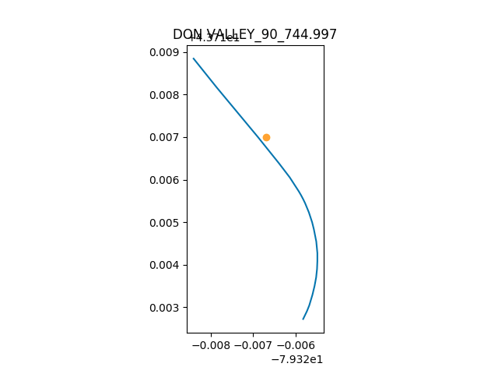
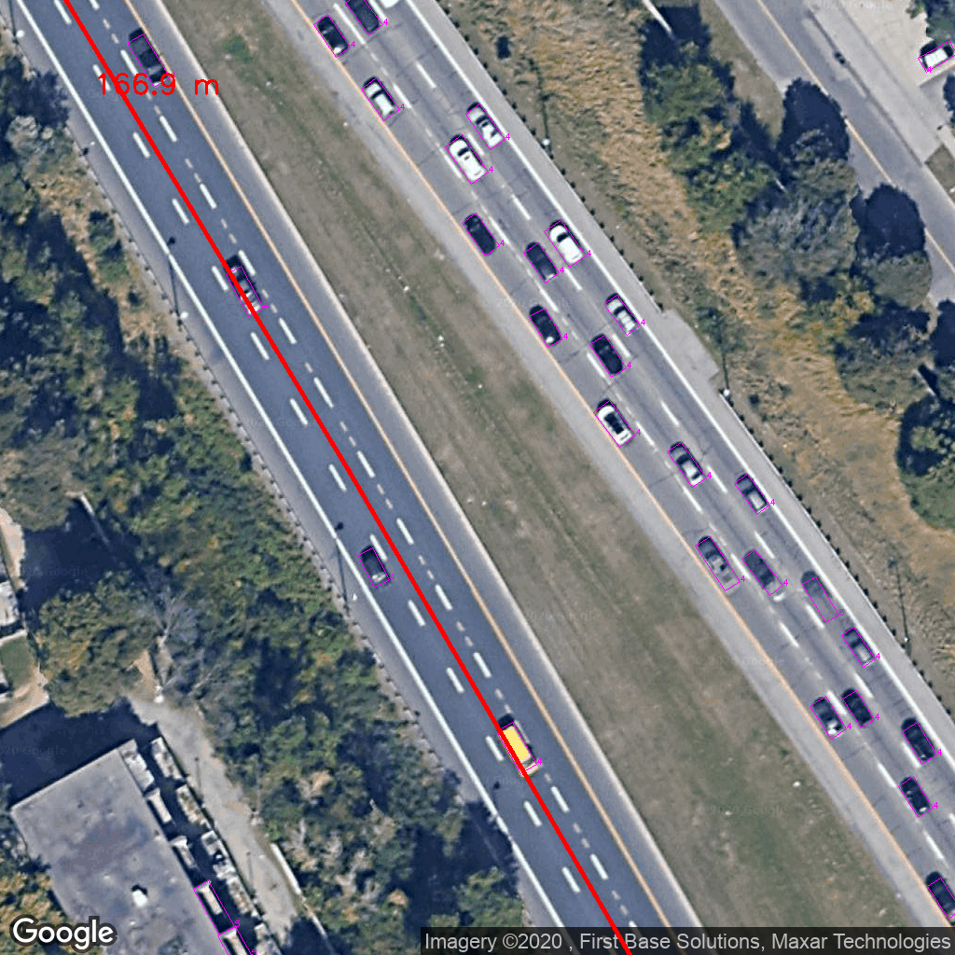
Add shapefile to image

Slide 3
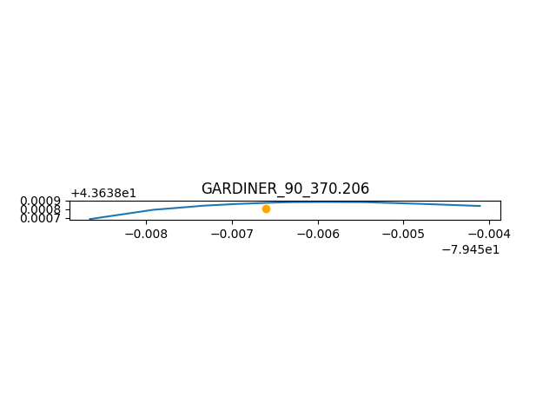
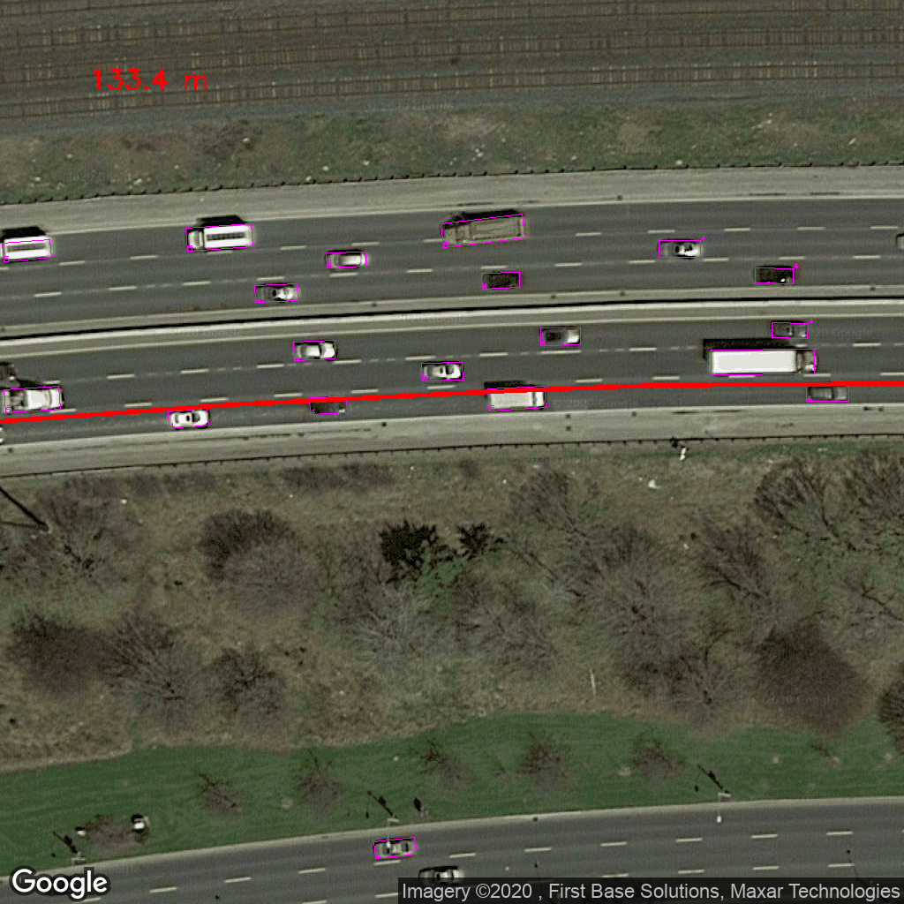
Add shapefile to image

Slide 4
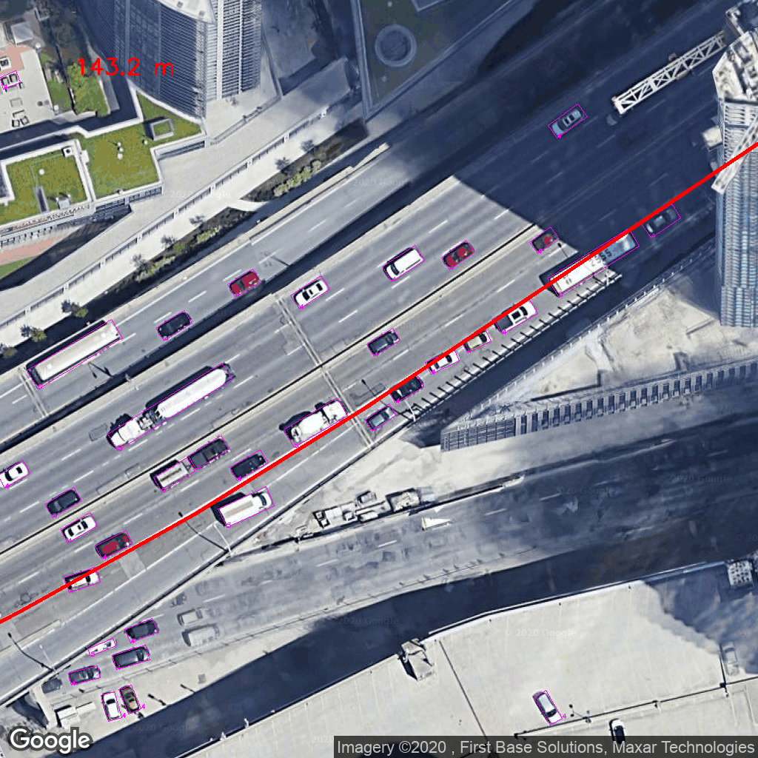
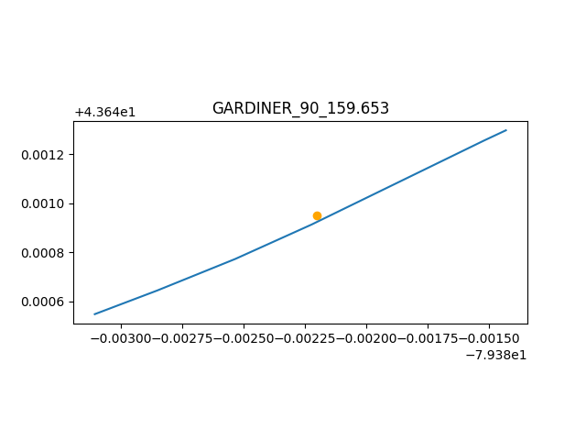
Add shapefile to image

Slide 5
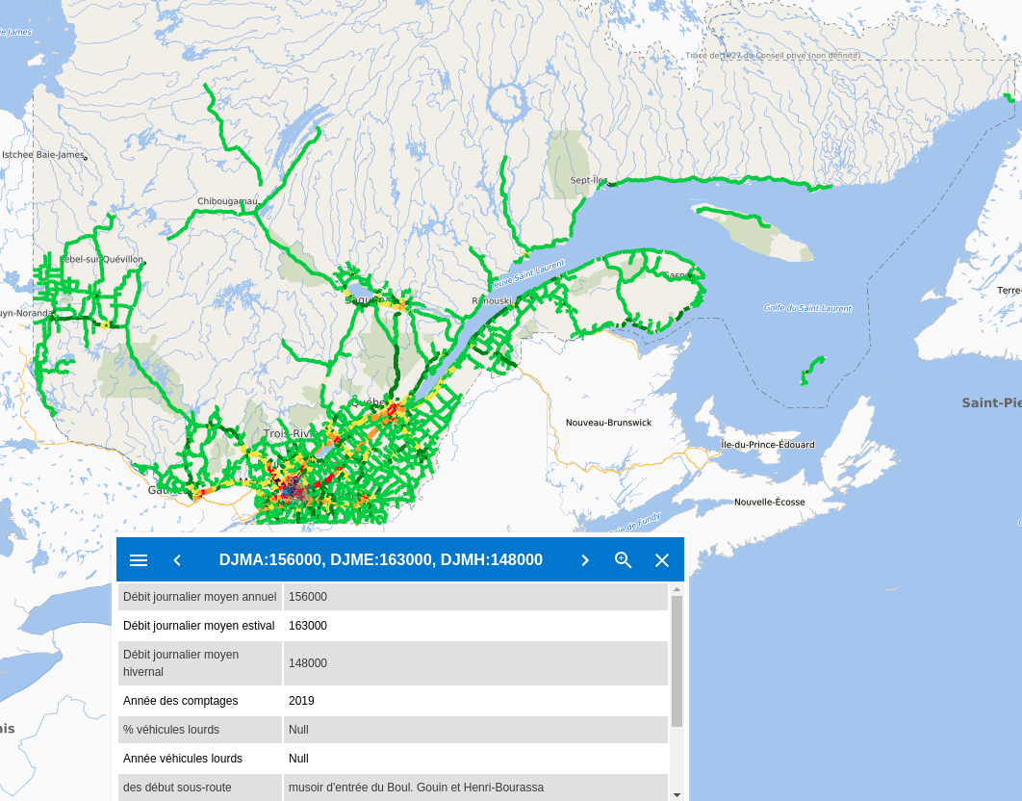

Traffic count (AADT) in Quebec
Source: Quebec Transport
Updated: 24 May 2019
Format: geojson
Valid: 3,871 principle roads

Slide 6
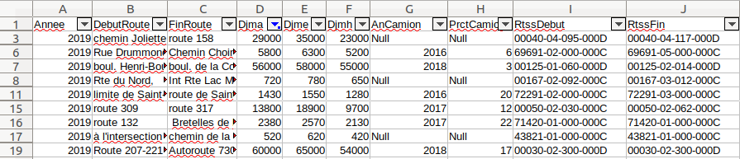
Traffic count (AADT) in Quebec
ADT in summer
Truck monitoring year
Year
Road direction
AADT
ADT in winter
Truck percentage

